Slide 1
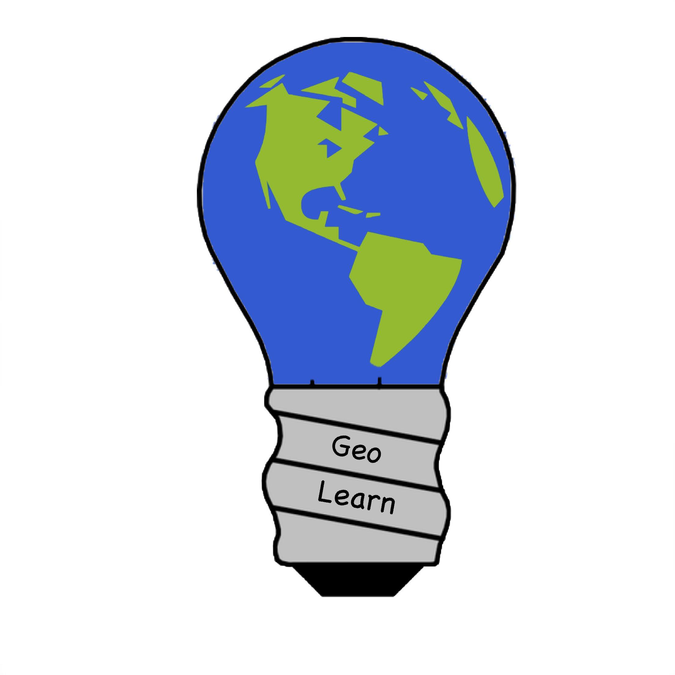
Improving Elementary Education with Custom Online
Presentations
Environmental Science Lectures
GeoLearn Members:
Samuel Prasse (leader),
Kaitlyn Grubb,
Tyler Pehringer,
Joshus Tenakhongva

Slide 2
Intro
How many of you know what the climate was where you were born and raised, compared to now?
How many of you know what type of animals lived in your backyard in the past?
We need to teach the next generation of kids what is going on around the world, or there might not be a world for the generation after that.

Slide 3
Why it Matters to Us
Misinformation
Educating children correctly
Help people become more invested in the environment
Notes:
Lot of misinformation
We want to teach the children right
We want them to be more invested in environmentalism through their local environment

Slide 4
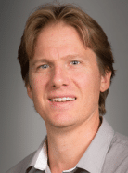
About Dr. Chris Doughty
Assistant Professor in ecoinformatics at Northern Arizona University
Ph.D in Earth System Science
Taught Ecosystems module at Oxford University
Wife Veronica is currently a teacher
Teaching for 10+ years
Has been researching for 15+ years
Has children in the school system

Slide 5
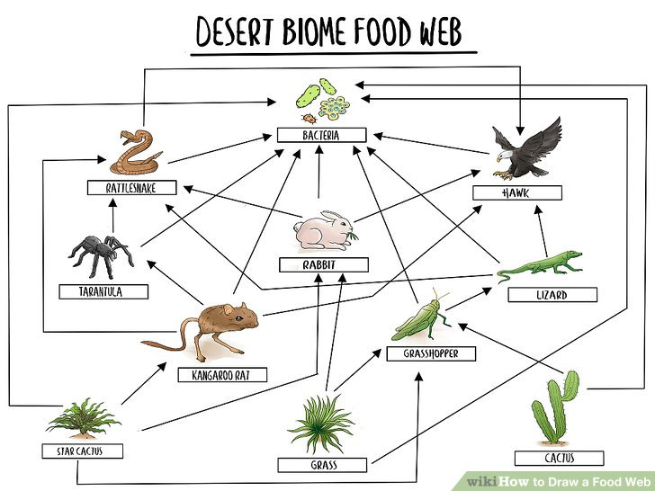
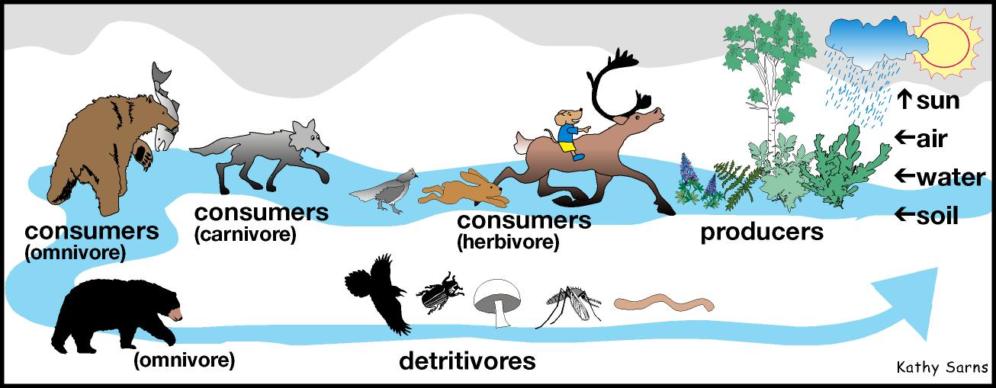
The Overview
Location Specialization
Allows for a better understanding due to familiarity
Age Specialization
Increases reusability and potential clients
Lecture Specialization
Allows the user to have an account and share slides
Increases potential users by networking

Slide 6



The Plan
User Testing
Asking teachers about the base version of the slides
Asking teachers which lecture are better for specialization
Receiving direct feedback on website UI from teachers
Django
Google API to pull data in order to create slides.
Permissions and account for grade specific content.
Link to google accounts for easy access to google slides
Past Capstone
Ecolocation
Access database to get megafauna at specified location
Use location based animal facts to help specialize lectures

Slide 7
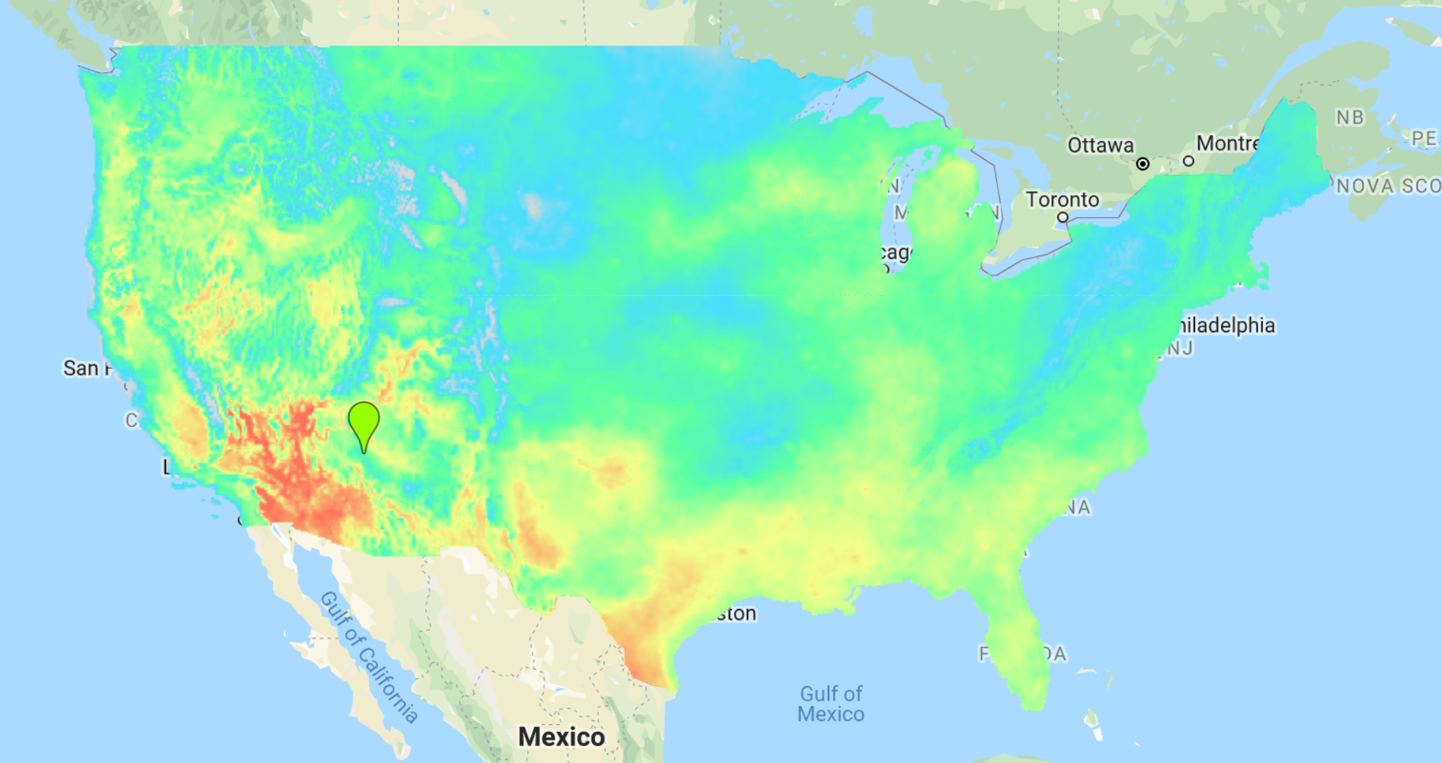
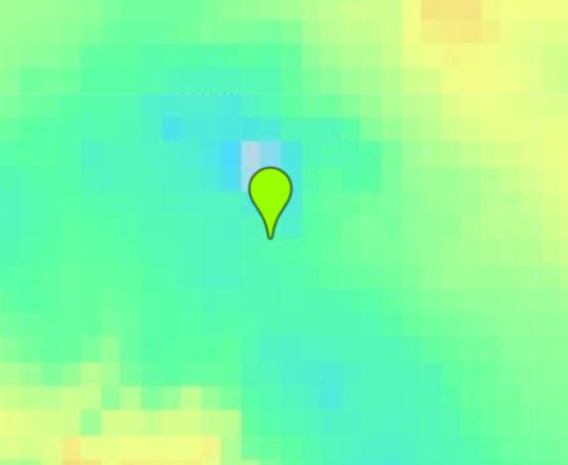
SLIDE EXAMPLES HERE
Notes:
Climate change

Slide 8
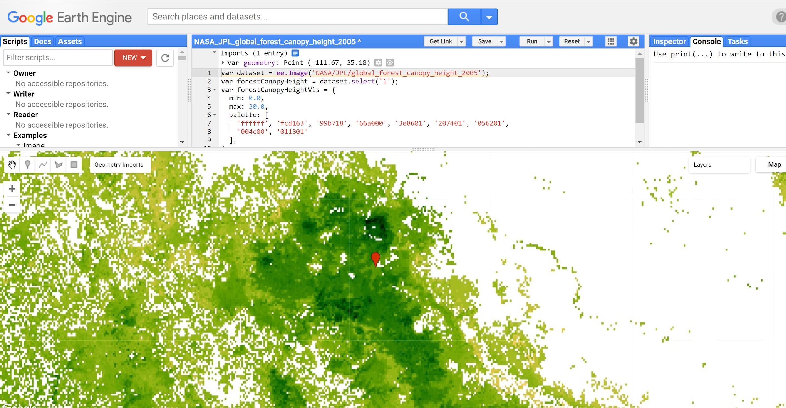

Slide 9
In Conclusion
We want to create better learning experiences for kids.
Through well organized and interactive presentations
We want to make a web application that not only engages kids, but has the information stick with them throughout their lives.
With this application, we have the potential to change the world.

Slide 10
References
https://www.arlis.org/docs/vol1/83599936/making_connection.html
https://www.wikihow.com/Draw-a-Food-Web
https://code.earthengine.google.com/?scriptPath=Examples:Datasets/IDAHO_EPSCOR_GRIDMET

